Slide 1
PREDICTIVE ANALYTICS

Slide 2
Task 2
For this task, you’ll likely need to use statistical software such as R, SAS, or Python.
Using the same transaction dataset, identify the annual salary for each customer
Explore correlations between annual salary and various customer attributes (e.g. age). These attributes could be those that are readily available in the data (e.g. age) or those that you construct or derive yourself (e.g. those relating to purchasing behaviour). Visualise any interesting correlations using a scatter plot.
Build a simple regression model to predict the annual salary for each customer using the attributes you identified above

Slide 3
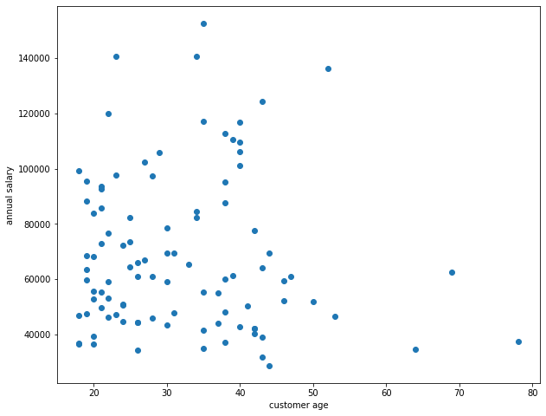
Exploratory Analysis
It is shown that the salary is more concerntrated around 45000 - 100000 between the age 20 to 50
Above 50 xustomers are payed relatively less than the younger age group
There is one customer with age above 50 years earning greater than 120K salary annually

Slide 4
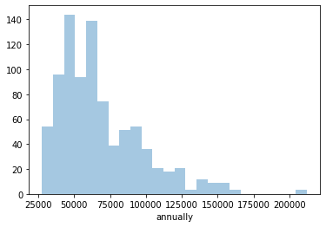
SIMPLE Linear REGRESSion
Salary distribution
Used Gender and monthly salary as the key variable

Slide 5
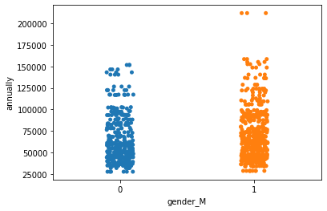
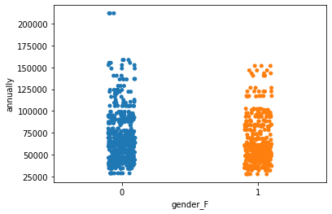

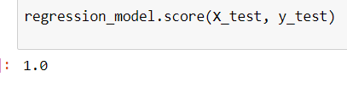
Plots for gender vs salary distribution
From the coefficients, we can say that, gender Male & monthly salary is highly significant.
As the data is not sufficient, the prediction accuracy is 100% is achieved

Slide 6
Thank you

